Slide 1


ALGORITHM ADVANCED
W1-S1 – COURSE INTRODUCTION

Slide 2






Self Introduction
Hongly Va (Ph.D.) (វ៉ា ហុងលី)
Lecturer & Researcher
Cambodia Academy of Digital Technology
+855-96-405-945-6
Hongly.va@cadt.edu.kh
Combined Master-PhD in Computer Graphics, Dept. of Software Convergence, Soonchunhyang University, Republic of Korea.
B.E. in the Dept. Information Technology Engineering, RUPP, Cambodia
7 SCIE journal publications (1st Author: 5, Co-author: 2)
1 Scopus Paper publication and 1 Domestic (Korea) paper publication
Conference proceedings (11 International Conference, 6 Domestic (Korea) Conference)

Slide 3

KICK OFF OBJECTIVES
Course Kick off
Overview of what you will be able to do at the end of this course
Overview of course map, learning objectives, evaluation and agenda
Rules about the usage of AI within this course and plagiarism
What we expect in terms of work and attitudes
Overview of the tools to work efficiently
A quick start
A short introduction to C++
Challenge yourself with a few problems!
Feedbacks
How this course can serve your future career?
What kind of involvement do you like to commit during this course?
References Documents

Slide 4



EXPLAIN
What you should be able to do
at the end of this course
3 examples to get the big picture

Slide 5
Optimizing Traffic Flow in Phnom Penh !
Design a system to optimize traffic light timings in Phnom Penh
THE DATA STRUCTURE
Each intersection and road can be modeled as a node and edge in a weighted graph where weights represent average traffic delays.
THE ALGORITHM
We can use advanced graph algorithms such as Minimum Cut to optimize traffic flow !

Slide 6
Water Distribution System Optimization
Minimize water loss and ensure efficient distribution to rural areas in Cambodia.
THE DATA STRUCTURE
Each reservoir, city, town, or village can be represented as a node in a graph, and each pipeline connecting these locations is an edge.
But we also need to use a priority queue, for shortest path calculation
THE ALGORITHM
WE can use Dijkstra’s Algorithm for shortest path calculation

Slide 7
Inventory Management for Supermarkets
Minimize water loss and ensure efficient distribution to rural areas in Cambodia.
THE DATA STRUCTURE
Implement hash tables for fast lookup, insertion, and deletion
Use a AVL tree to efficiently categorize and search items based on multiple criteria.
PERFORMANCE ANALYSIS
We can compare the time complexity of various operations with large datasets, simulating a real-world inventory system.

Slide 8
COURSE MODULES
Dynamic Tables
Trees
3
Abstract Data Types
ABSTRACT
DATA STRUCTURES
Linked Lists
Graphs
2
Algorithm Complexity
Sorting Algorithms
ANALYSIS OF ALGORITHMS
1
From C to C++
Dynamic Memory
Classes & Objects
C++ BASICS

Slide 9



COURSE OBJECTIVES
Understand C++ syntax and object-oriented approach
Understand the concepts of algorithm complexity
Understand the functioning of abstract data types (ADT)
KNOW
Conduct performance analysis for a given algorithm
Specify an abstract data type
Justify the factors that influence the choice of an ADT for a given problem
Solve a real-world problems using an appropriate ADT
SKILLS
Cultivate collaborative learning
- Give and receive feedback
- Teamwork spirit to solve complex problems
- Openness to reconsider and improve your solutions
Develop an analytical approach to justify your technical choices
Develop rigor and discipline in programming
BEHAVIORS

Slide 10

COURSE EVALUATION
TYPE OF EVALUATION | RATIO
Attendance and class participation | 10 %
Quizzes | 10 %
Practice Assessments | 10 %
Peer review Assessments | 10 %
Project | 30 %
Exam | 30 %

Slide 11
COURSE AGENDA
 | Learning | Exam | Practice | Project | Industry
W 01 | C++ Basics
W 02 | C++ OOP
W 03 | Algorithms complexity
W 04 | ADT & Linked Lists
W 05 | Stack / Queue
W 06 | Review & Project |  |  | Project proposal | Seminar Day
W 07 | Tree
W 08 | Graph
W 09 | Real world problems
W 10 | Let’s end | Final Exam |  | Project Jury

Slide 12
A week in Algorithm Advanced
Our expectations in terms of work and attitudes
HOME
Perform SELF-LEARNING assignments
Perform RESEARCHES assignments
THEORY
SESSION
Cultivate COLLABORATIVE LEARNING
Give and receive feedback
Teamwork spirit to solve complex problems
Openness to reconsider and improve your solutions
We recommend you to spend
6 hours per week
Of personal work, outside of class
Review concepts
Write your OWN NOTES
Write your OWN CODE
HOME
PRACTICE
SESSION
PARTICIPATE ACTIVELY in group activities
HOME
Submit the PRACTICE BEFORE THE DEADLINE
Submit the SELF-ASSESSMENT SURVEY

Slide 13

COURSE ATTITUDES
‘’It always easy to be passive and sit back’’
The real learning happens when you try by your own
This is where thing get really scary !
This is where you challenge your own skills set
This is where you really learn

Slide 14
GOLD RULES !
1
2
3
4
5
TAKE
NOTES
TRY BY
YOUR OWN
ORGANIZE YOUR TIME
LEARN FROM
PEERS
TRUST
YOURSELF
Keep
key concepts
and examples of code
Challenge your own skills set
This is where you really learn
Give yourself deadlines
Avoid procrastination
Give & Receive
Feedback
Don’t stay alone
Everyone is different !
It's your difference that makes the difference

Slide 15

Rules about the usage of AI within this course and plagiarism

Slide 16
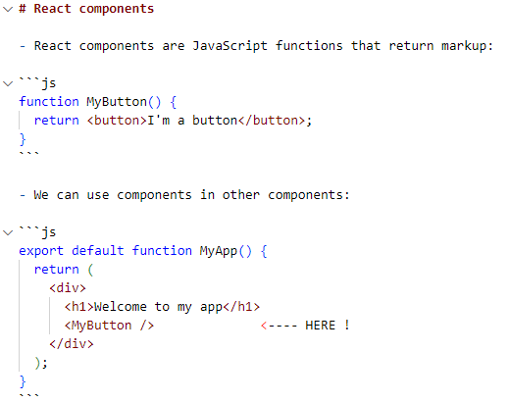
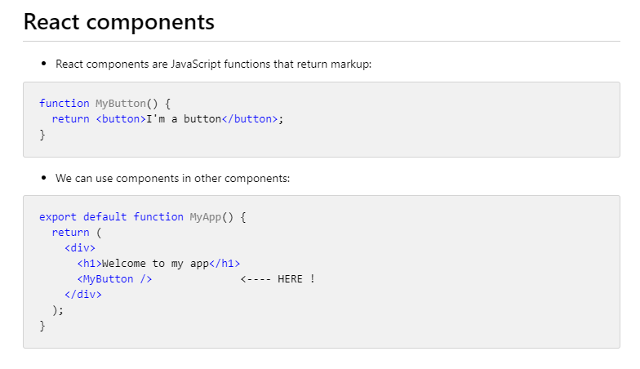
TOOLS
Take notes with MarkDown
Markdown (MD) is an easy-to-use language to keep your notes organized !

Slide 17
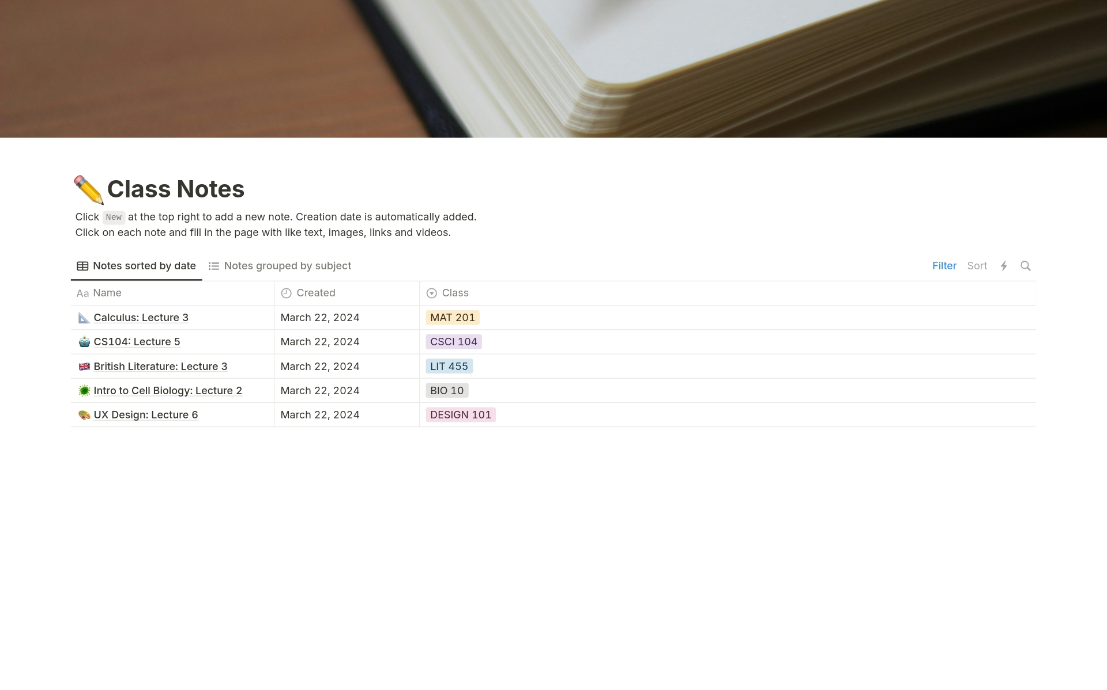
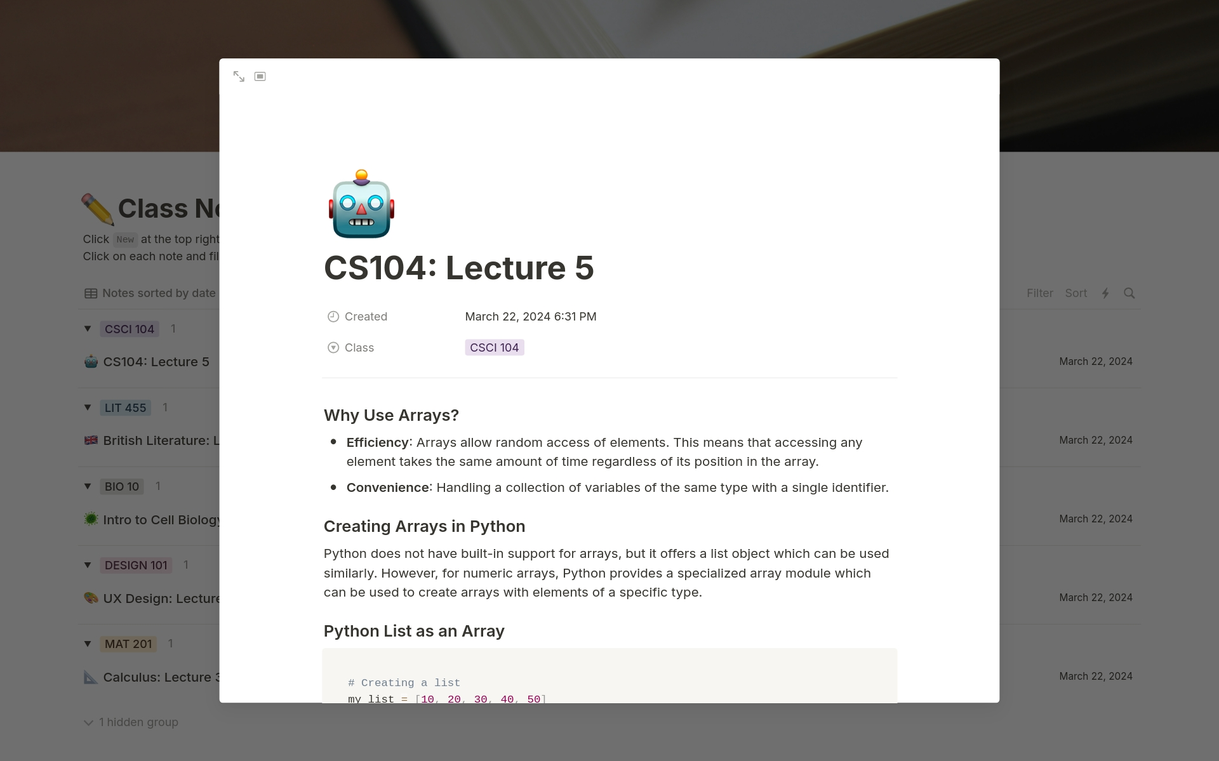

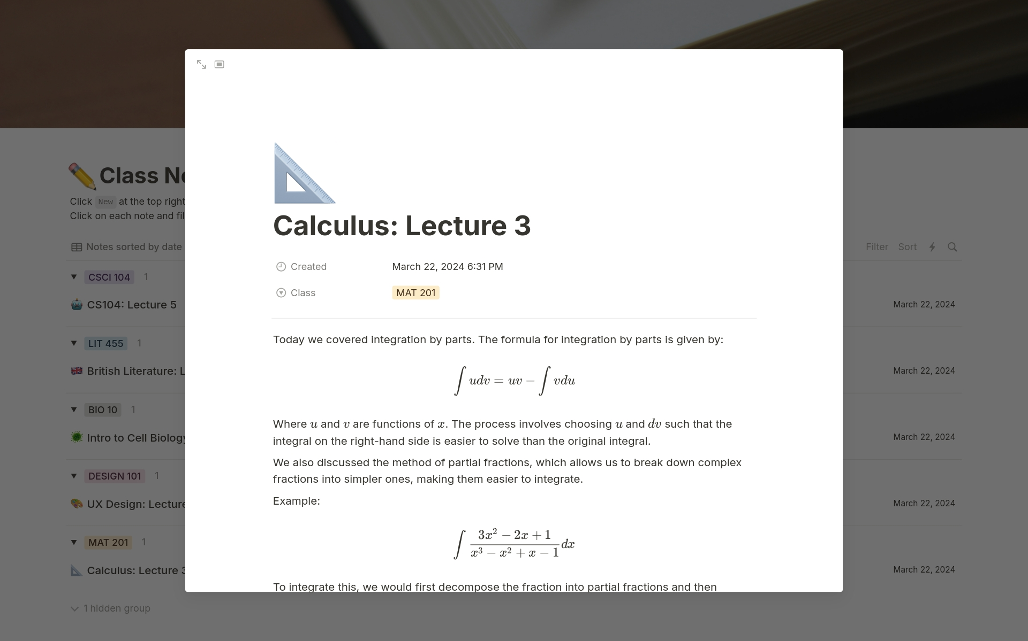
TOOLS
Take notes with Notion
Notion is a single space where you can think, write, and plan.
Notes:
https://notion-templates.notion.site/4cf06a17688f4ea78c7c2f2ac555b6a2?v=f7578c416f004d5c885f6625171d6a04

Slide 18


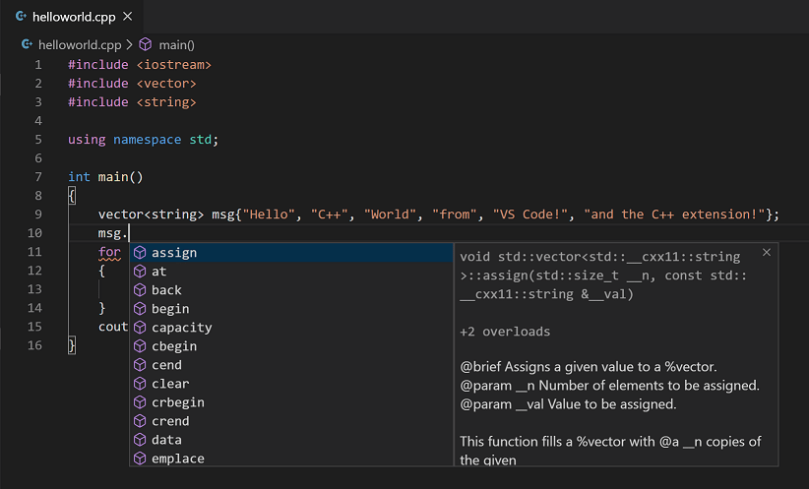
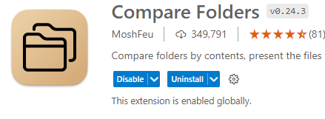
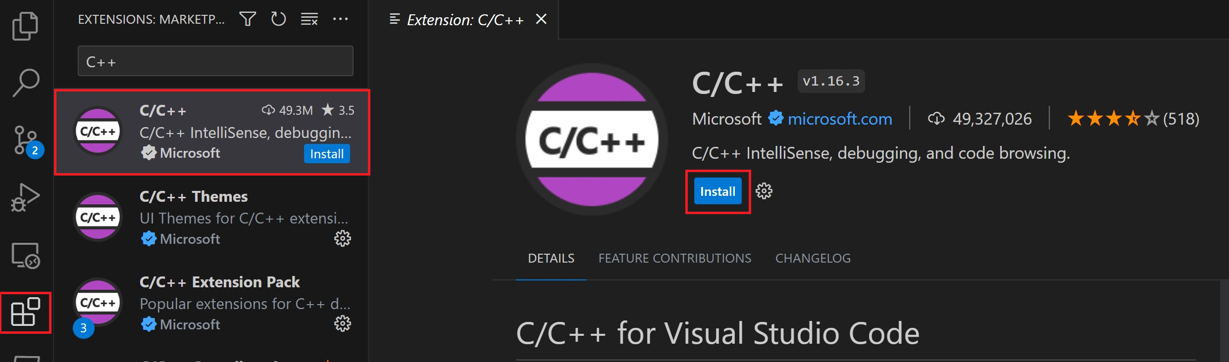
TOOLS
VS Code for C++
CLICK HERE FOR FULL GUIDE

Slide 19


MS Team For Education
How to use MS Team for this course ?
CLICK HERE FOR FULL GUIDE

Slide 20

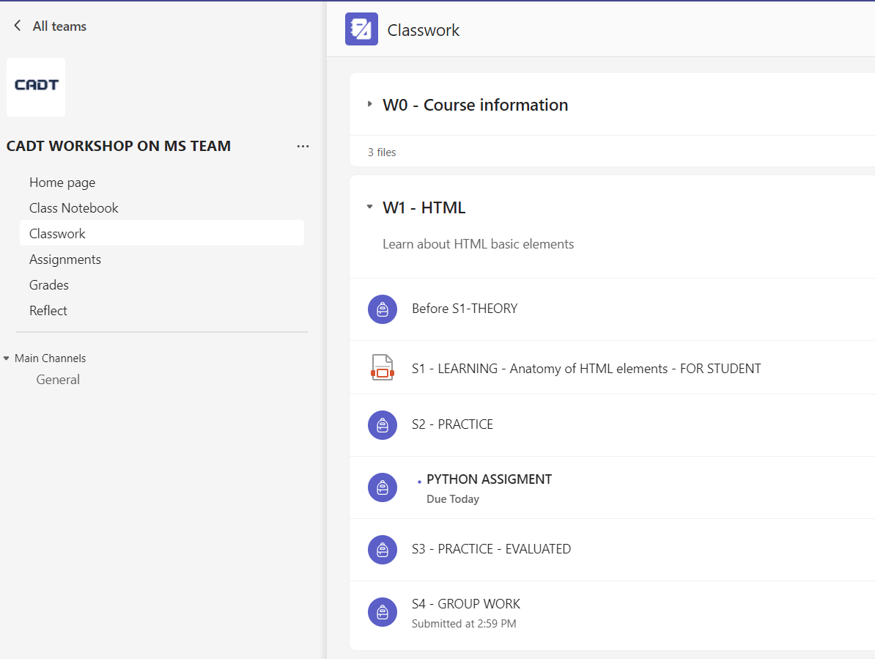
MS Team – User Interface
General information about the course
The Classwork is the place to structure the learning experience
Check your grades, your reflections
Communicate with your peers !

Slide 21
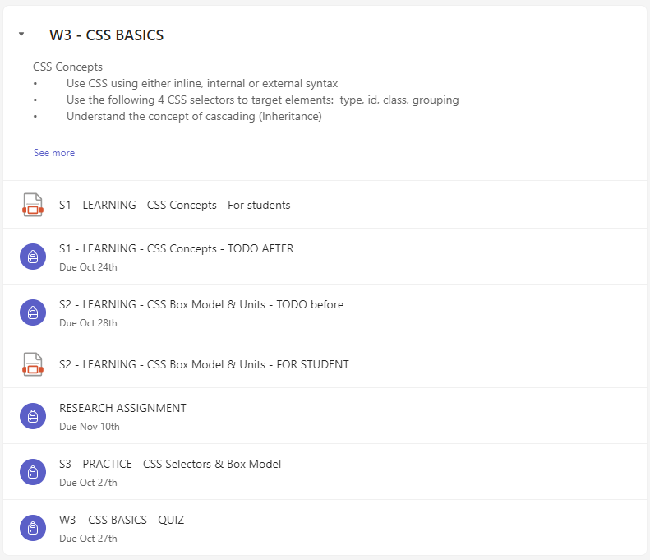
A Week Work in MS Team
From zero to Hero !
After the theory class, you have to review the concepts
And train yourself with some activities !!
Before the theory class, this time !!
you have to watch some video to be ready enough
Slides or other documents
To read
Research task !
You have to prepare a research and present it later on
Practice !
You will have to provide us your GitHub path or a ZIP file with your code
Quiz !
Evaluate your skills ! Time to see what you need to progress on

Slide 22

A short introduction to
What’s new in C++
OOP
Standard Template Library (STL)
Function Overloading
Namespace Support
Common Ground with C:
Syntax similarities (control structures, basic data types, functions…)
Can compile most C code as C++.

Slide 23

A short introduction to C++: Demo

Slide 24
Challenge yourself with a few problems!
Q1 – Do you remember the Pre-Assessment Test?
Q2 – Can you do it in C++?
Q3 – What kind of support do you need?

Slide 25


PRESENTATION
Your feelings about this course !
10 MIN
Group discussion + Presentation to the whole class
Q1 - How this course could serve your future career?
Q2 - What kind of involvement do you like to commit during this course?
Q3 – What are your concerns and your needs?

Slide 26

RESSOURCES FOR THIS COURSE
Course books
Problem Solving in Data Structures & Algorithms Using C++ Hemant_Jain_ 2016
Learning Algorithms Through Programming and Puzzle Solving
Grokking-Algorithms (Aditya Bhargava - 2016)
Cracking-the-Coding-Interview
Data Structure & Algorithms Resources
https://www.tutorialspoint.com/data_structures_algorithms/index.htm
C++ Resources
https://cplusplus.com/doc/tutorial
https://cplusplus.com/reference/
https://google.github.io/styleguide/cppguide.html
Tools
Online C++ debugger and visualizer
https://pythontutor.com/cpp.html#mode=edit
Online C++ IDE
https://replit.com/
https://onecompiler.com/cpp

Slide 27
AFTER THIS SESSION
FOR NEXT TIME
1 – XX
You will have a quiz based on this session objectives:
Benefits of class vs structures
Class attributes & methods
Class instantiation and constructors
Class members visibility
Use this as a reference to current object
Pass objects by value or by reference
2 – XX
Be ready to present your researches
Differences btw static and dynamic instantiation
Differences btw memory allocation and deallocation
Static vs. dynamic instantiation (pro & cons)

